Slide 1
EECE 7398: Advances in deep learning
IMAGE HARMONIZATION THROUGH ATTENTION ENHANCED U-NET WITH COMPOUND LOSS

Slide 2
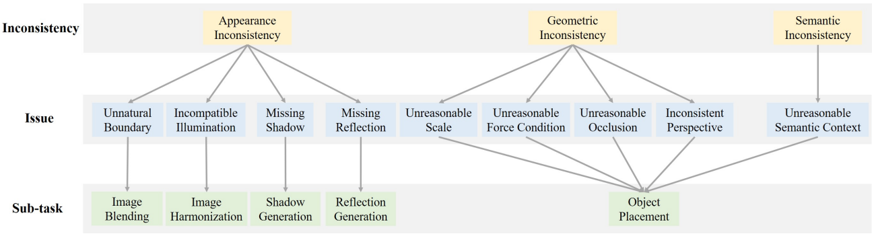
Introduction – image composition
Image composition aims to cut the foreground from one image and paste it on another image, resulting in a composite image
After compositing a new image with foreground and background, there exist many issues that could make the composite image unrealistic and thus significantly degrade its quality.
There has been no attempt to address all issues with one unified model
Transfer of color statistics
Issue and subtask

Slide 3
Introduction – Image harmonization
Image Harmonization is the process of transforming a composite image by adjusting its foreground appearances to be consistent with the background region to improve realism.
It has applications, for instance, in movies when objects are to be added to scenes, and color corrected to match the background
Transfer of color statistics
Examples of composite and harmonized foreground from iHarmony4 github

Slide 4
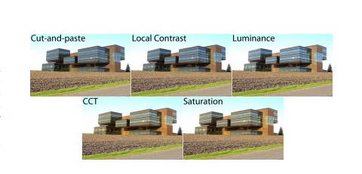
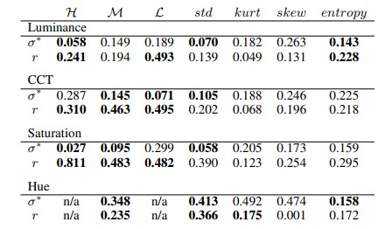
Related work
Reinhard et al. align the means and variances of the color histograms of the two image regions. Adobe Photoshop’s widely used “Match Color” feature is based on this concept.
Xue et al. identify image statistics that are correlated with composite realism and conclude that the most correlated features are found in luminance, saturation and CCT.
Results from Xue et al correlation correction
Quantitative results showing deviation and correlation

Slide 5
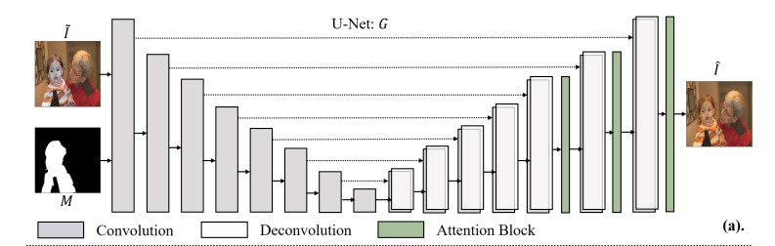
Related work – deep learning based
Cong et al. proposed DoveNet, a novel deep image harmonization method using an attention enhanced U-net generator and a domain verification discriminator.
Ling et al. introduce Region-aware Adaptive Instance Normalization as an alternative to Instance normalization used in DoveNet, that provides learnable parameters and normalization done separately in the background and foreground areas.
BargainNet uses an attention enhanced generator and a 6-layer Vgg to extract features from the foreground and background separately using partial convolution and computes a loss function.
U-net generator used by all methods above

Slide 6
motivation
Our motivation to solve this problem stems from these related works and involves combining some ideas from previously mentioned research.
Since the foreground and background areas are vastly different in out input, separating the feature maps by their masks in normalization proved to be effective in Rain-Net.
Why not do a similar separation while computing the loss function since the desired output is only changes in the foreground area?
The initial color transfer methods that rely on color representations of the foreground and background image provide decent results when compared to other non deep learning methods.
Why not use these to compute a loss function more representative of the problem at hand?

Slide 7
Initial ideas / methods
Our idea is to use the attention enhanced U-net architecture and formulate a compound loss function that involves the L1 loss for reconstruction along with one or more losses.
Using a VGG with partial convolutions to extract feature maps from hue, saturation maps and comparing the respective feature maps to produce a loss function to be fed to the generator.
Using a gram matrix for to find the differences between the input and target foregrounds as used in style transfer methods.
Using an enhanced U-Net architecture such as the U-Net 3Plus to improve generator results.
Using an ensemble of the above-mentioned models to generate more realistic composites.

Slide 8
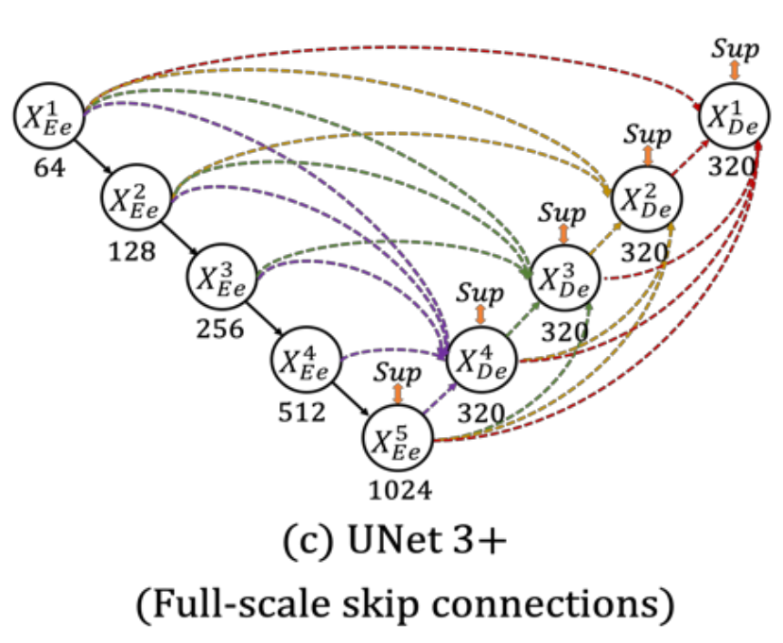
unet3
The U-net 3Plus has an enhancement over U-net in changing the skip connections.
The skip connections, instead of directly passing through the input feature maps, they are passed through a convolutional layer, along with activation and is then concatenated.
We used this architecture as a generator in the model.
Batch normalization showed better results than instance normalization in the skip layers.
The parameters and therefore training time are increased while training.

Slide 9
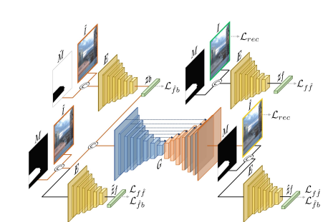

Hue saturation value
We passed images in the HSV color space to the discriminator. The hue and saturation brings out a good similarity between the composite and real image for the task at hand.
The discriminator used a VGG type architecture, with 6 layers of partial convolutions and instance normalization.
The composite image, real target image, generator output was passed along with the mask and a triplet loss was used with these 3 values.
We found that the inclusion of HSV data gave improved results over passing RGB data to the VGG with partial convolutions.

Slide 10
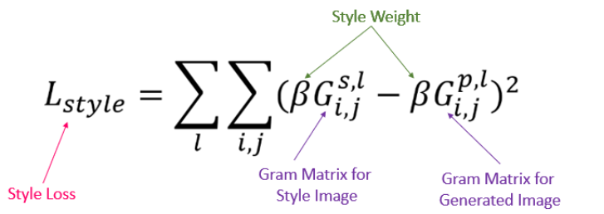
Style loss
The style loss is computed from the gram matrix, which is the result of multiplying a given matrix by its transposed matrix, and the MSE loss is calculated from this.
The style differences between the color shifted foreground and the target image are captured. The image is cropped according to the mask and the style loss is calculated.
Adding a style loss multiplied by a weight (0.01) in our studies, we saw an improvement in the evaluation of the model.

Slide 11
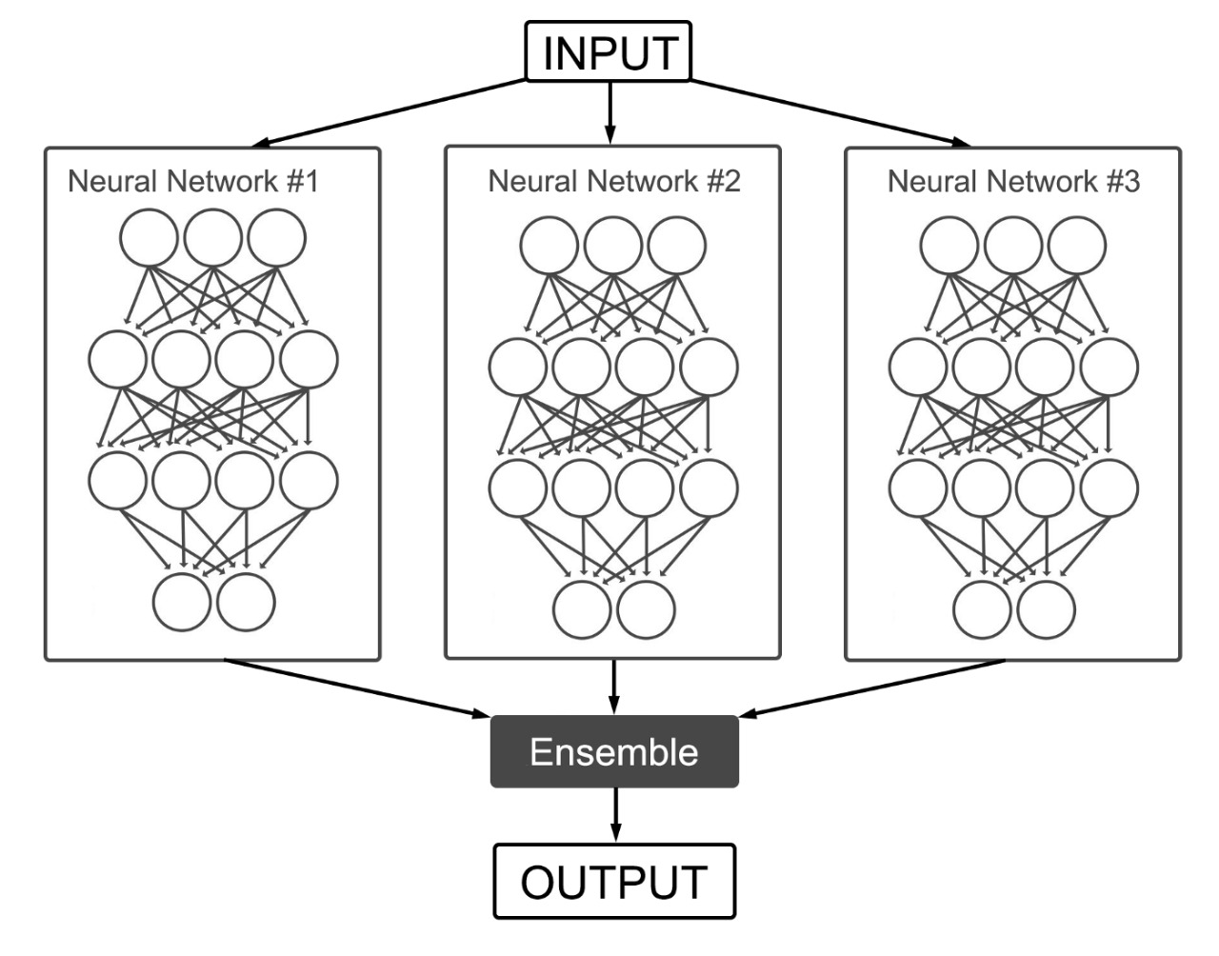
Ensemble
Training multiple neural network models and combining their results into one is called Ensemble Learning.
We have used multiple bargain-net models with slightly different architecture models for ensembling.
This allows the models to reduce variance of predictions, thereby leading to better generalization.
We take the corresponding pixel average for each channel respectively to ensemble the results.

Slide 12
results
Method | MSE | PSNR
Lalonde and Efros | 110 | 31
Xue et al. | 77 | 32
DoveNet | 35 | 35
BargainNet | 29 | 37
Unet-3Plus | 79 | 32
Unet + VGG(RGB) | 60 | 34
Unet + VGG(HSV) | 48 | 34
Ensemble | 37 | 37

Slide 13
THANK YOU

